Slide 1
Dreadnought
CS 442 - Fall 2024 Team 3
By: Kent Lizardo, Adrian Knight, Giridhar Patri

Slide 2
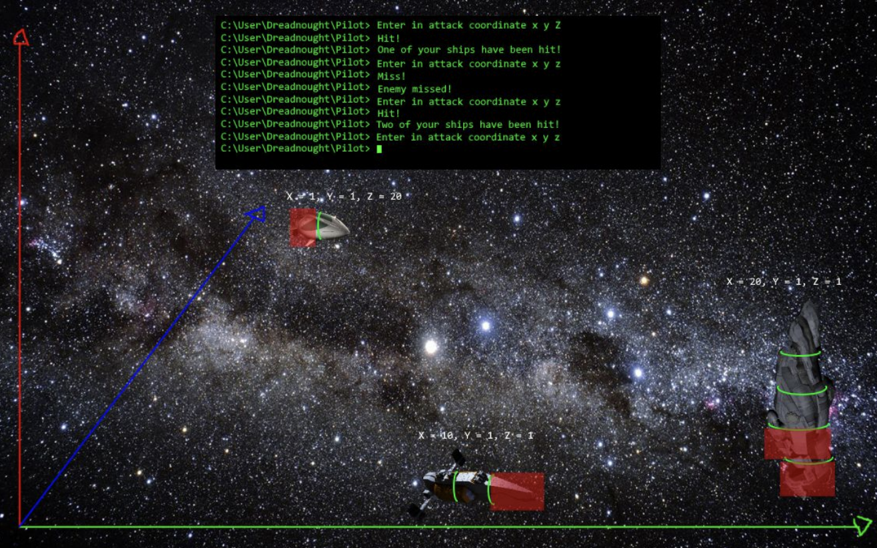
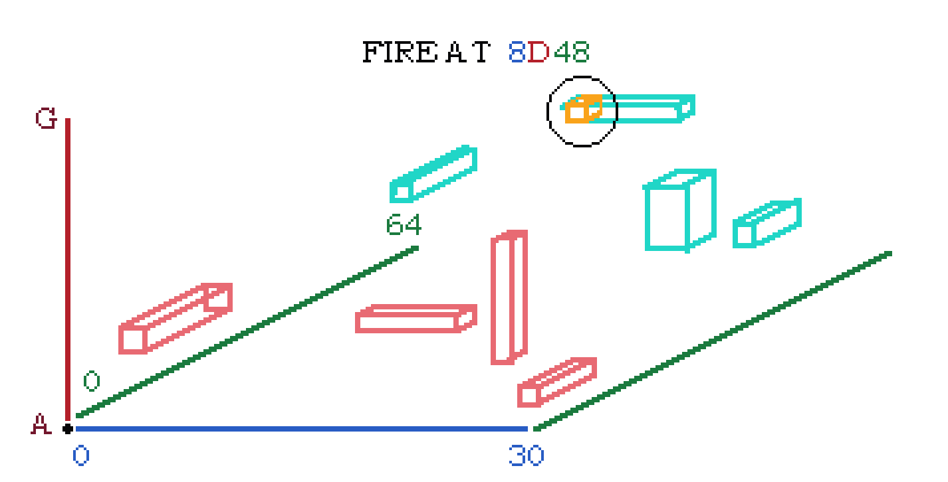
Project Design
Project specifications written and designed by Darius Alasu, Jamie Rodica, Alexander Vanberkum, Jeremy Wong (CS 442 Fall 2020, Group 14).
Figure 1: Adapted from: Darius et al. “Development Report Final Summary”
Figure 2: Based on designs from Darius et al.

Slide 3
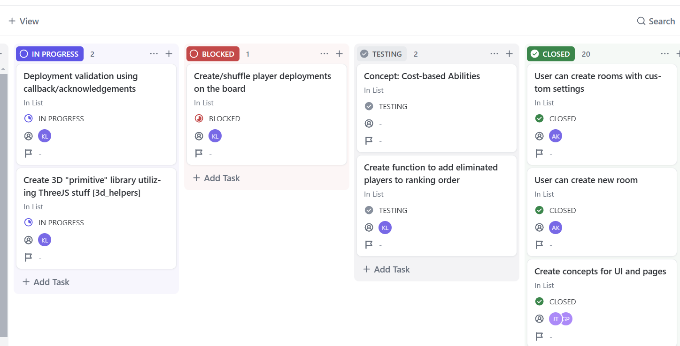
CASE Tools Used
ClickUp Board (KanBan)
Git and GitHub
Monorepo composed of Backend and Frontend
Weekly Scrum Meetings

Slide 4


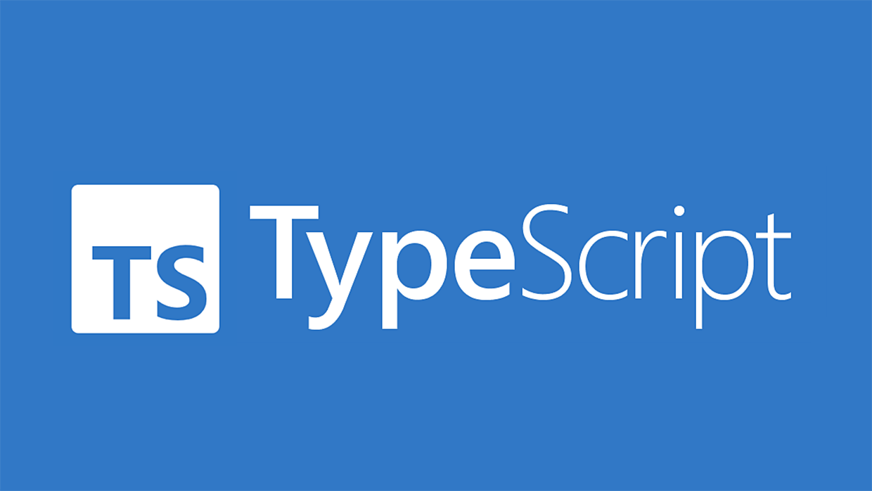

Project Tech Stack

Slide 5
Design and Refactoring Lessons
Intentionally creating code smell of Data Classes in shared library
Unified communication between server and client.
Created an easier way to implement privacy/separation of information.
Writing a library class
Black box testing of a “minimum” game helped. No explicit assertions, but defining correct debug readouts of game data.
Helped find inaccuracies in data sent from server and client as well as invalid game logic.
Instances represented by immutable data and functional components.
Frontend composed of “viewer” components.
Increased complexity of transactions.
Unique class instances needed a UID to be referred to by client.

Slide 6
Challenges during Development
Scheduling weekly meetings on Friday right before the weekend. Missed several reports towards the end of semester.
Alternative could be scheduling weekly meetings on Mondays instead.
Peer Programming was helpful in only a handful of cases.
Largely dependent on work environment and schedule.
Kanban usage was not as effective
WIP Limits were not strictly enforced. Tasks were shifted due to rapidly changing priorities around deadlines.

